Slide 1

Catholic Schools Week 2025
Notes:
Image from: https://catholiceducation.ie/catholic-schools-week-2025-alive-in-christ/

Slide 2
‘Christ is alive! He is our hope, and in a wonderful way he brings youth to our world, and everything he touches becomes young, new, full of life. The very first words, then, that I would like to say to every young Christian are these: Christ is alive and he wants you to be alive!’
(Pope Francis, Christus Vivit, 1)

Slide 3
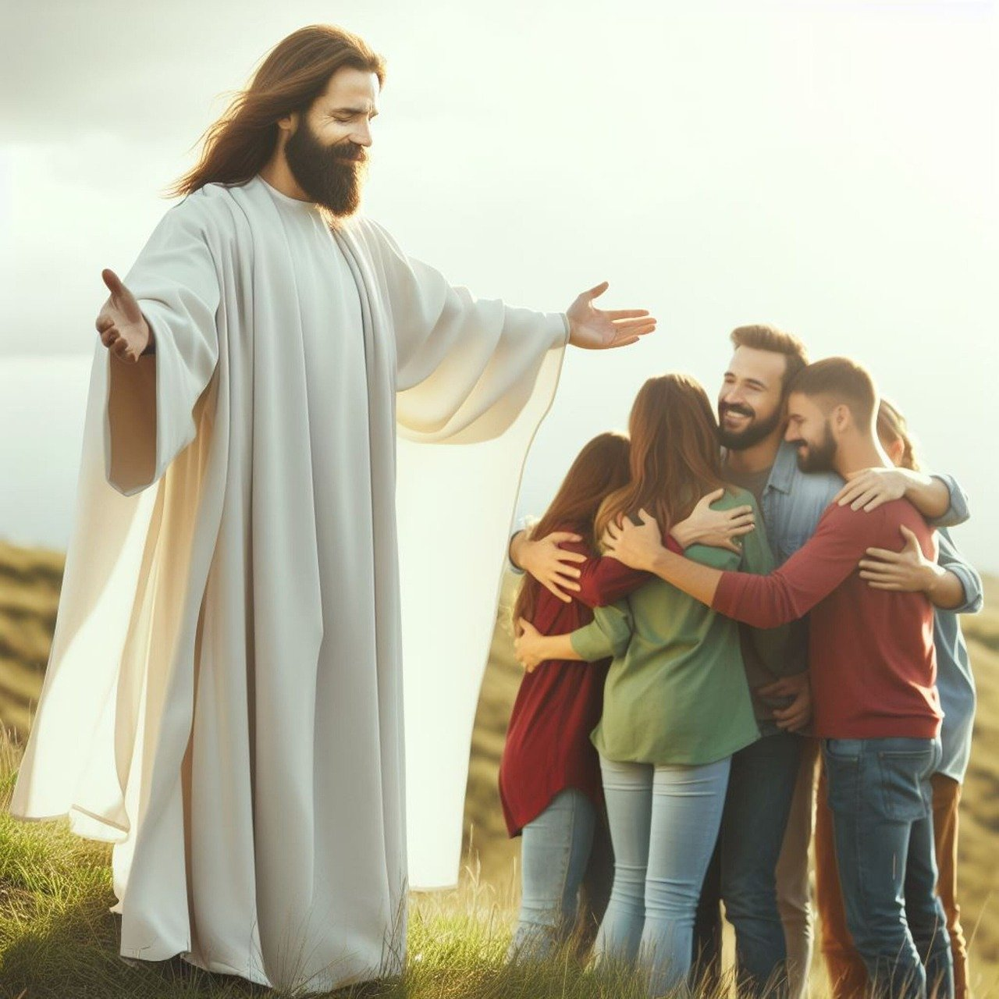
‘The very first truth I would tell each of you is this: “God loves you”. It makes no difference whether you have already heard it or not. I want to remind you of it. God loves you. Never doubt this, whatever may happen to you in life. At every moment, you are infinitely loved.’
(Pope Francis, Christus Vivit, 112)
Notes:
Image from: https://pixabay.com/illustrations/jesus-god-help-support-together-8385575/

Slide 4
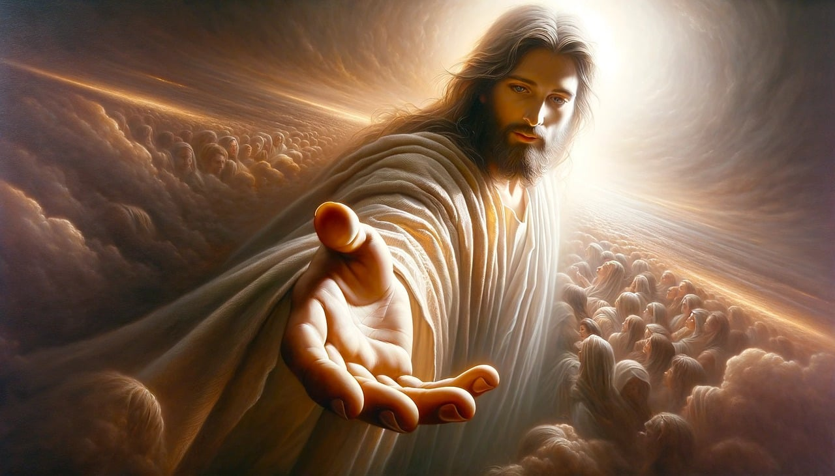
Friendship is one of life’s gifts and a grace from God. Through our friends, the Lord refines us and leads us to maturity. Faithful friends, who stand at our side in times of difficulty, are also a reflection of the Lord’s love, his gentle and consoling presence in our lives.
(Pope Francis, Christus Vivit, 151)
Notes:
Image from: https://pixabay.com/illustrations/ai-generated-jesus-god-faith-8785905/

Slide 5

‘The experience of friendship teaches us to be open, understanding and caring towards others, to come out of our own comfortable isolation and to share our lives with others. For this reason, “there is nothing so precious as a faithful friend” (Sir 6:15).’
(Pope Francis, Christus Vivit, 151)
Notes:
Image from: https://pixabay.com/photos/young-sea-friend-outdoors-beach-8208513/

Slide 6

‘Friendship is no fleeting or temporary relationship, but one that is stable, firm and faithful, and matures with the passage of time. A relationship of affection that brings us together and a generous love that makes us seek the good of our friend. Friends may be quite different from one another, but they always have things in common that draw them closer in mutual openness and trust.’
(Pope Francis, Christus Vivit, 152)
Notes:
Image from: https://pixabay.com/photos/people-joy-smile-holiday-friends-2295052/

Slide 7

‘Friendship is so important that Jesus calls himself a friend: “I do not call you servants any longer, but I call you friends” (Jn 15:15). By the gift of his grace, we are elevated in such a way that we truly become his friends. With the same love that Christ pours out on us, we can love him in turn and share his love with others, in the hope that they too will take their place in the community of friendship he established.’
(Pope Francis, Christus Vivit, 153)
Notes:
Video link: https://youtu.be/csoLvZB_MdA

